Slide 1
Introducing Clustering Algorithms
Scott O’Hara
Metrowest Developers Machine Learning Group
03/03/2021

Slide 2
References
The material for this talk is primarily drawn from the notes, slides and lectures of the courses and book below:
MOSTLY:
DS 5230 Unsupervised Machine Learning and Data Mining – Fall 2018
Northeastern University, Prof. Jan-Willem van de Meent
https://www.khoury.neu.edu/home/jwvdm/teaching/ds5230/fall2018/
A FEW THINGS:
Applied Machine Learning in Python
University of Michigan, Prof. Kevin Collins Thompson
https://www.coursera.org/learn/python-machine-learning/home/welcome
The Hundred-Page Machine Learning Book (Ch. 9)
Andriy Burkov
http://themlbook.com/

Slide 3
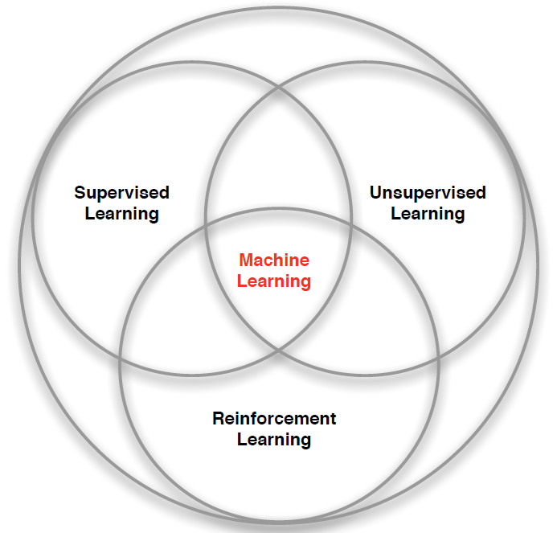
3 Types of Machine Learning
Supervised Learning – Learn a function from labeled data that maps input attributes to an output label e.g., linear regression, decision trees, SVMs.
Unsupervised Learning – Learn patterns in unlabeled data e.g., principle component analysis or clustering algorithms such as K-means, HAC, or Gaussian mixture models.
Reinforcement Learning – An agent learns to maximize rewards while acting in an uncertain environment.
Credit: image borrowed from lecture slides David Silver, DeepMind, “Introduction to Reinforcement Learning

Slide 4
What is Unsupervised Learning?
Unsupervised learning involves tasks that operate on datasets without labeled responses or target values.
The goal is to discover interesting structure or information in the dataset.
Reference: Applied Machine Learning in Python. Coursera. University of Michigan, Prof. Kevin Collins Thompson

Slide 5
Applications of unsupervised learning
Visualize structure of a complex dataset.
Density estimation to predict probabilities of events.
Compress and summarize the data.
Extract features for supervised learning.
Discover important clusters or outliers.
Reference: Applied Machine Learning in Python. Coursera. University of Michigan, Prof. Kevin Collins Thompson

Slide 6
Four Kinds of unsupervised learning
Density Estimation
Model the probability density function of the unknown probability distribution from which the dataset has been drawn.
Dimensionality Reduction
Finds an approximate version of a dataset using fewer features while retaining some meaningful properties of the original data.
Outlier Detection
Detect the examples in the dataset that are very different from what a typical example in the dataset looks like.
Clustering
The task of grouping a set of objects in such a way that objects in the same group (called a cluster) are more like each other than to those in other groups (clusters).
References:
The Hundred-Page Machine Learning Book. Andriy Burkov.
Applied Machine Learning in Python. Coursera. University of Michigan, Prof. Kevin Collins Thompson
Cluster analysis, https://en.wikipedia.org/w/index.php?title=Cluster_analysis&oldid=1002271612 (last visited Jan. 27, 2021).
Dimensionality reduction, https://en.wikipedia.org/w/index.php?title=Dimensionality_reduction&oldid=1002754996 (last visited Jan. 27, 2021).

Slide 7
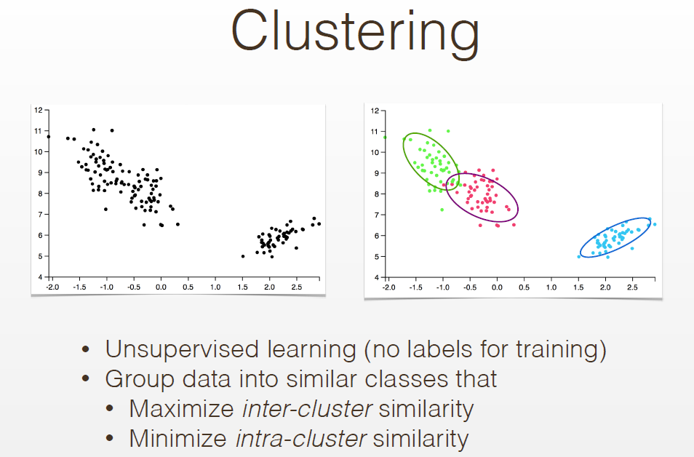

Slide 8
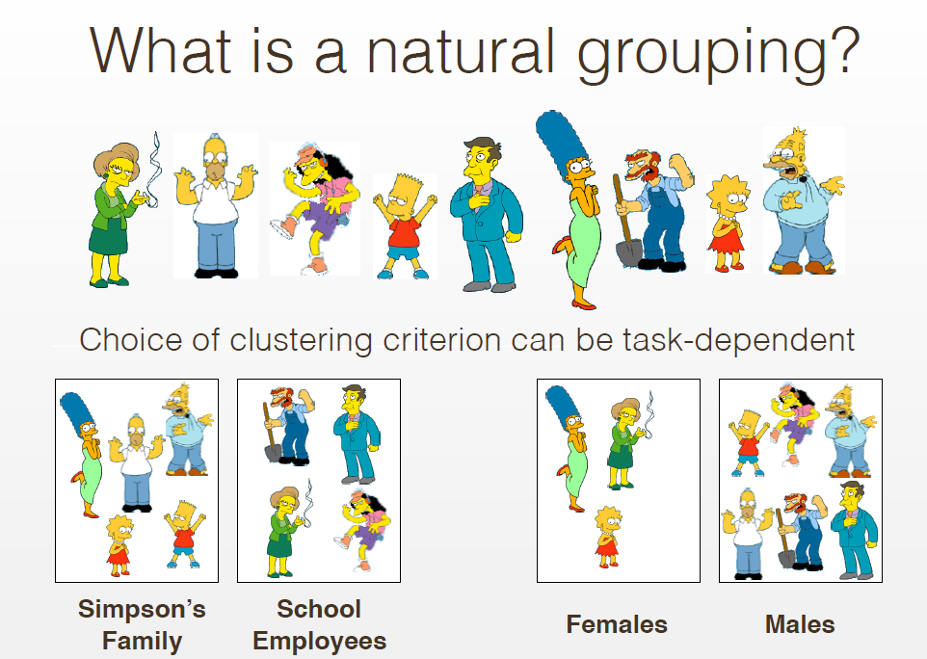

Slide 9
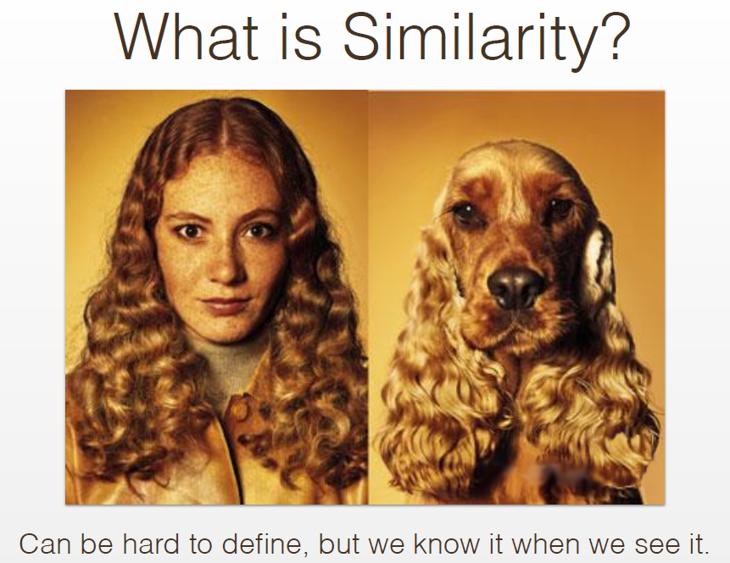

Slide 10
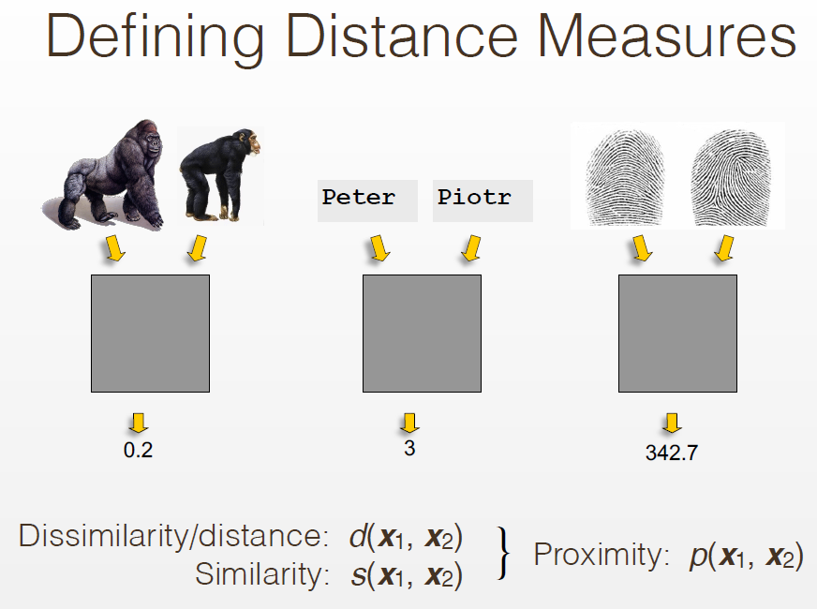

Slide 11
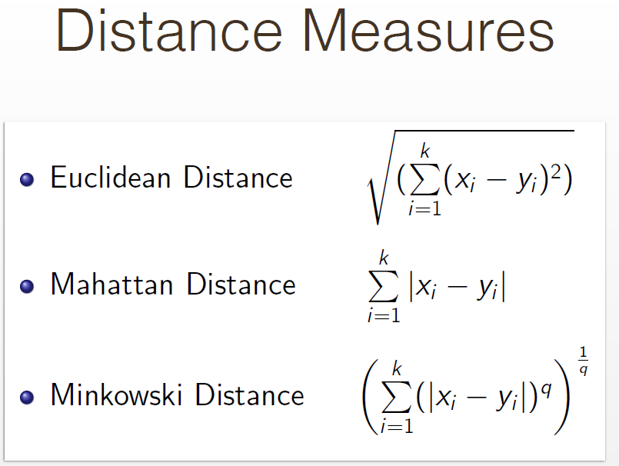

Slide 12
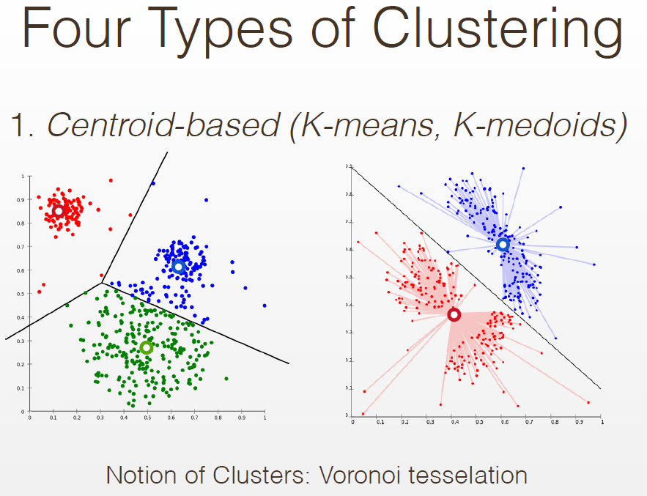

Slide 13
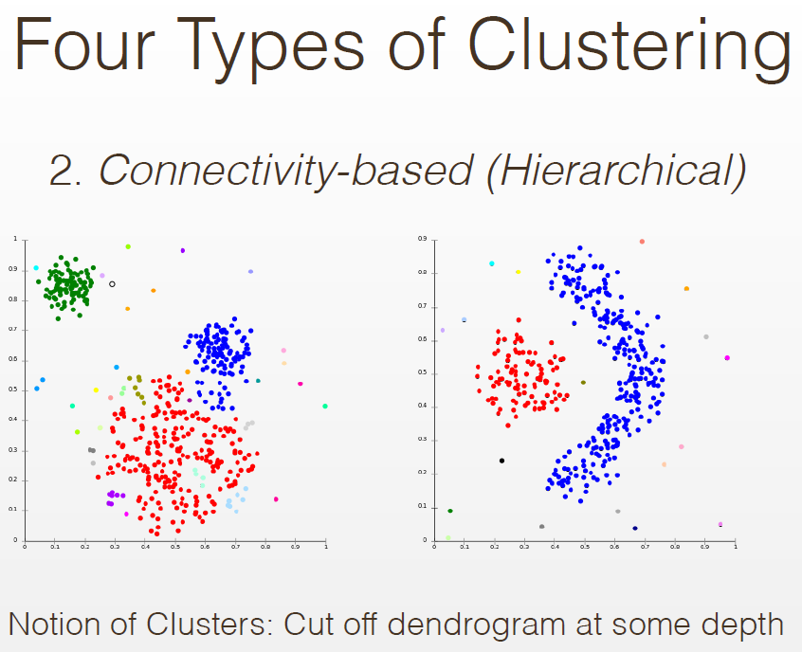

Slide 14
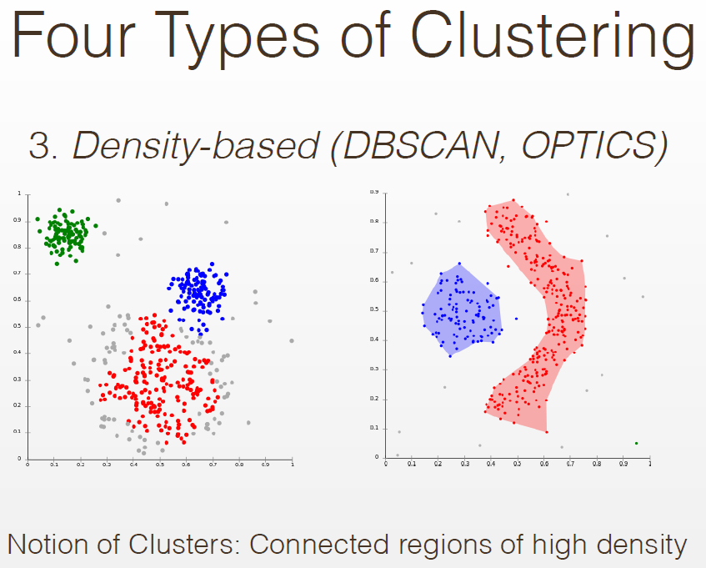

Slide 15
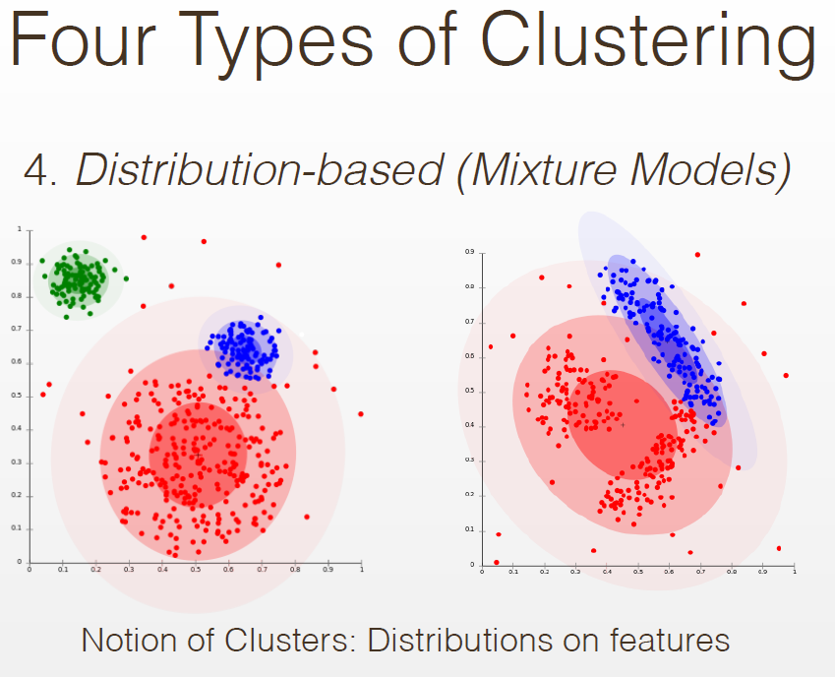

Slide 16
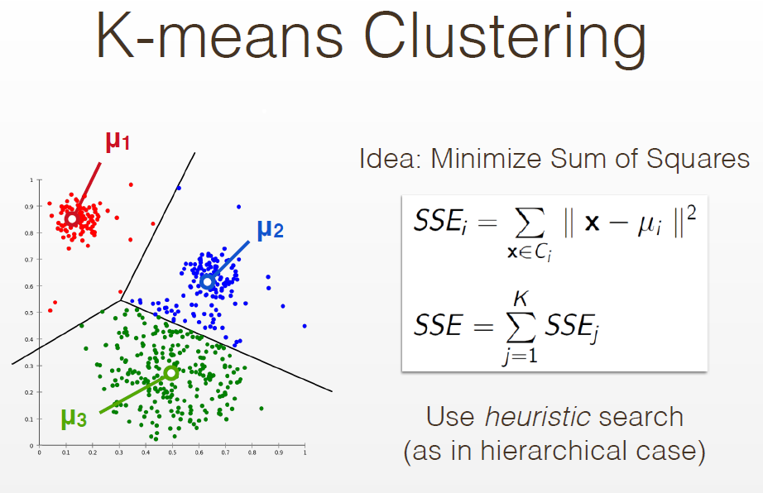

Slide 17
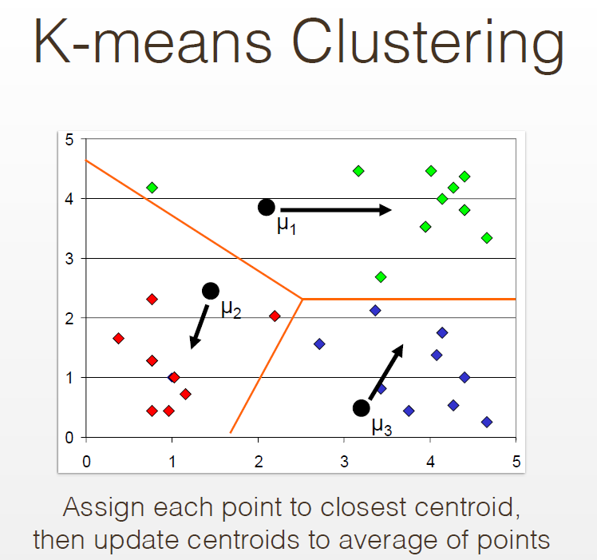

Slide 18
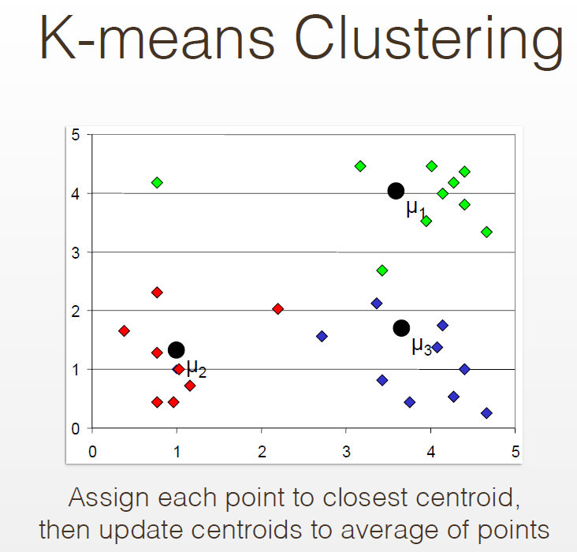

Slide 19
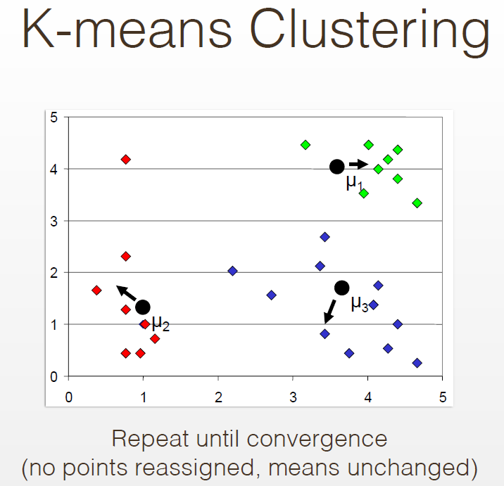

Slide 20
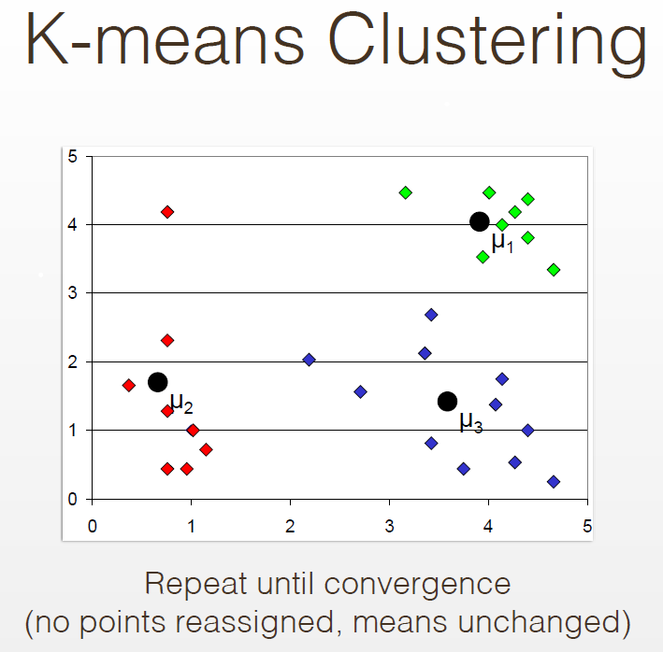

Slide 21
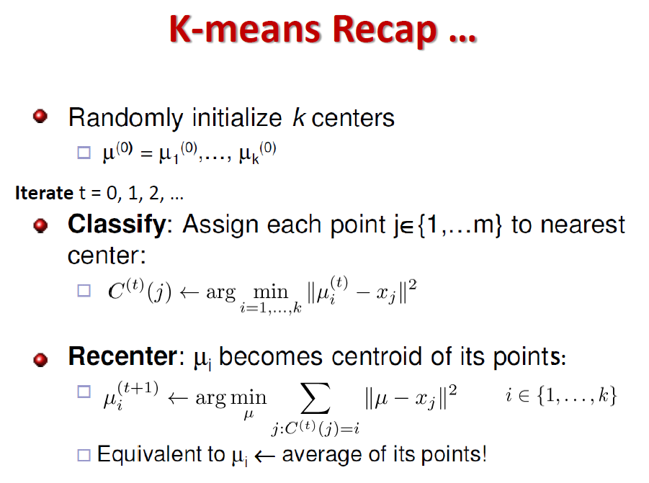

Slide 22
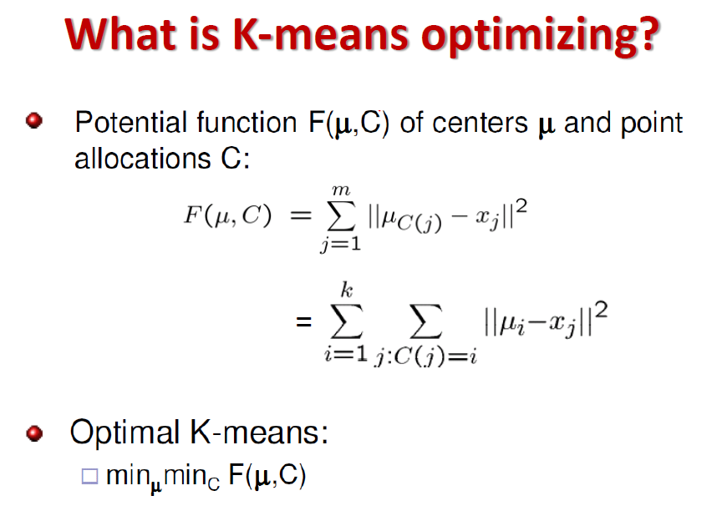

Slide 23
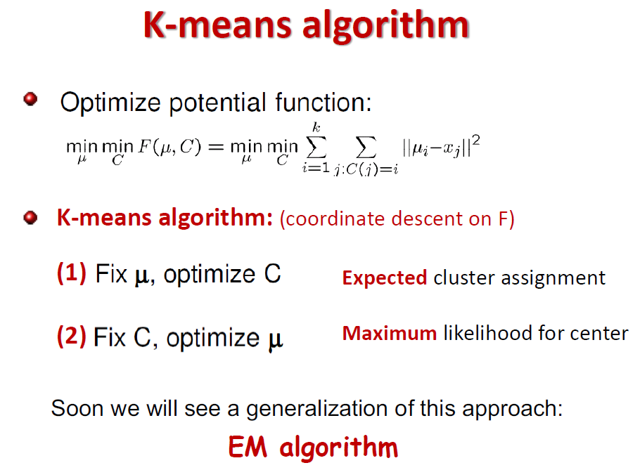

Slide 24
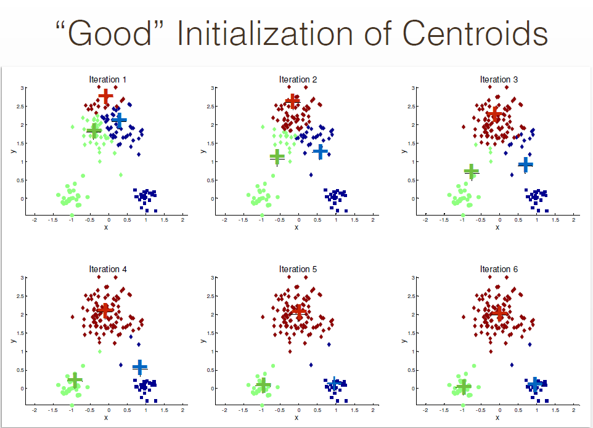

Slide 25
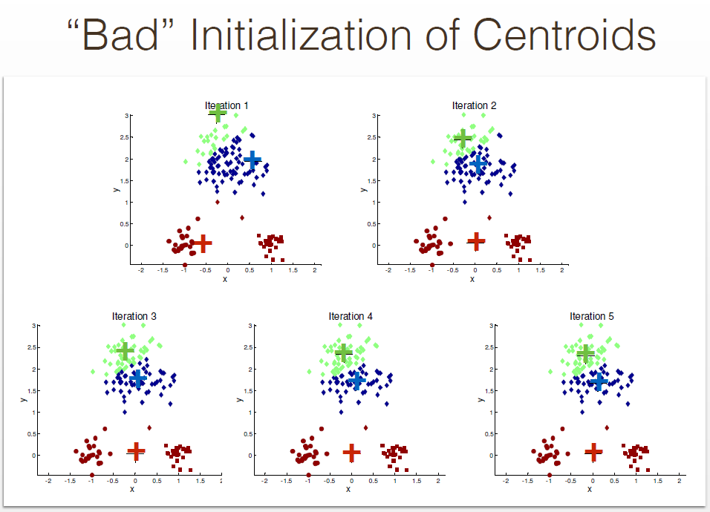

Slide 26
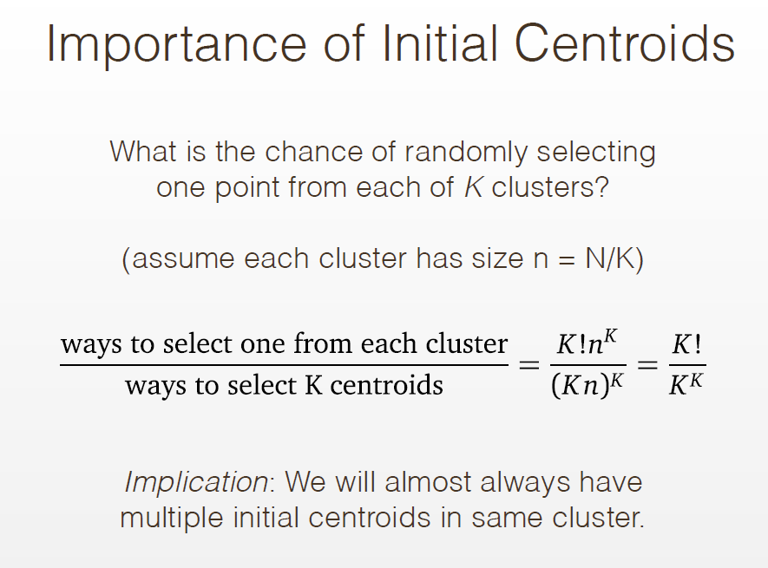

Slide 27
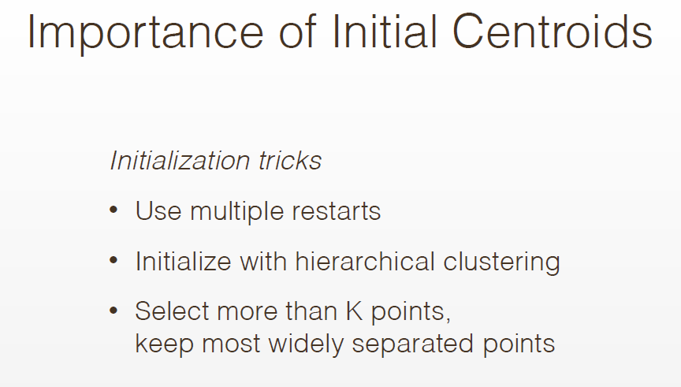

Slide 28
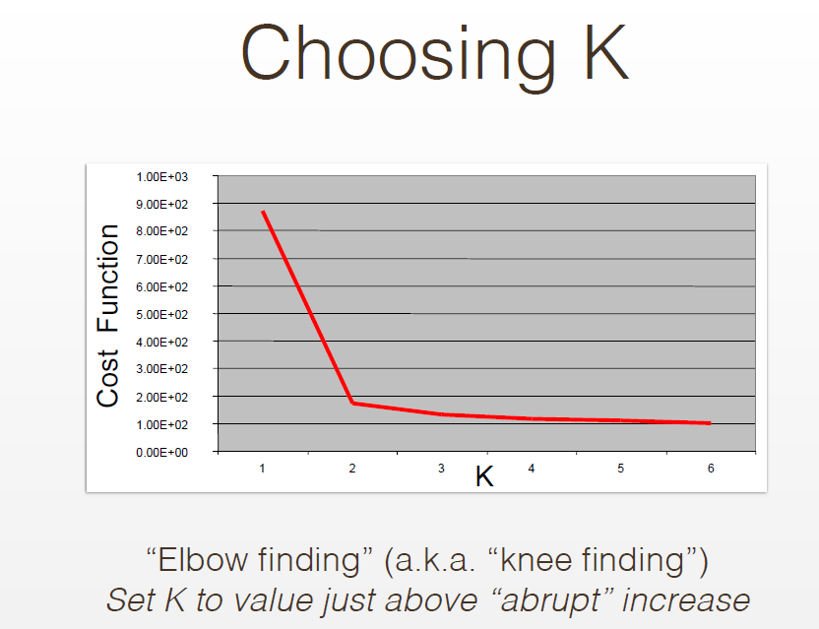

Slide 29
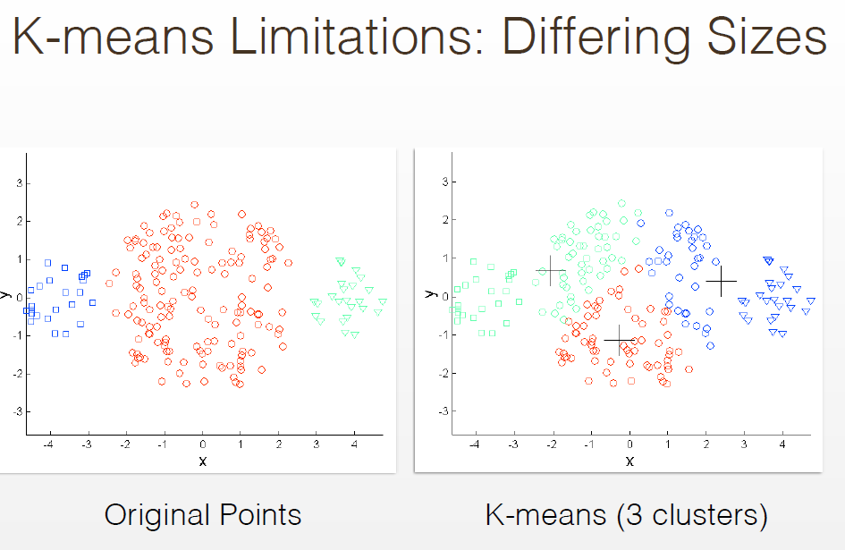

Slide 30
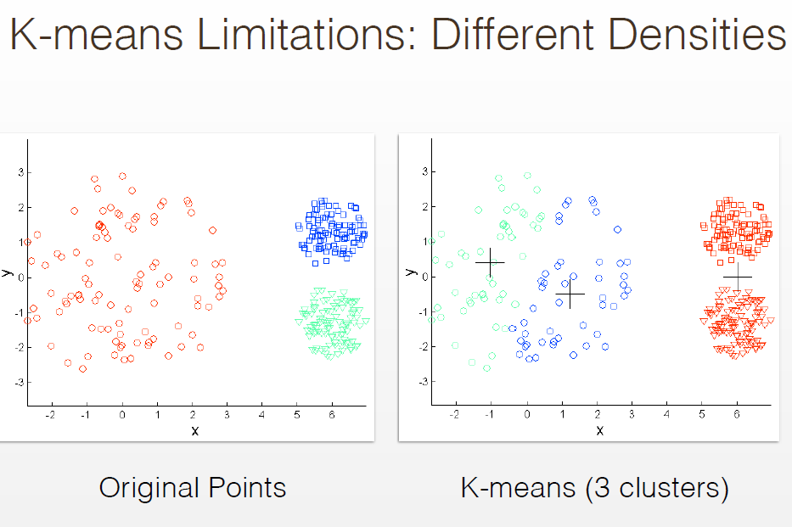

Slide 31
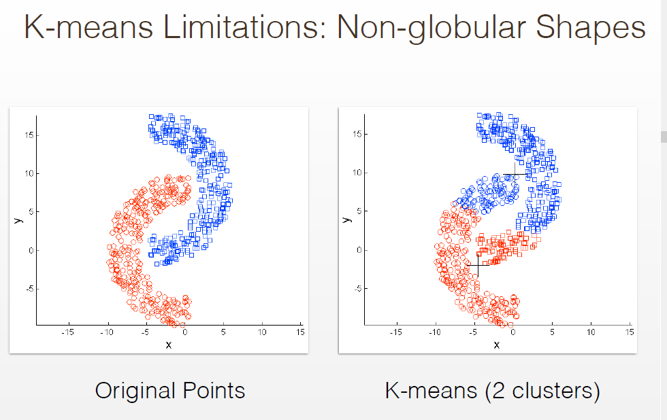

Slide 32
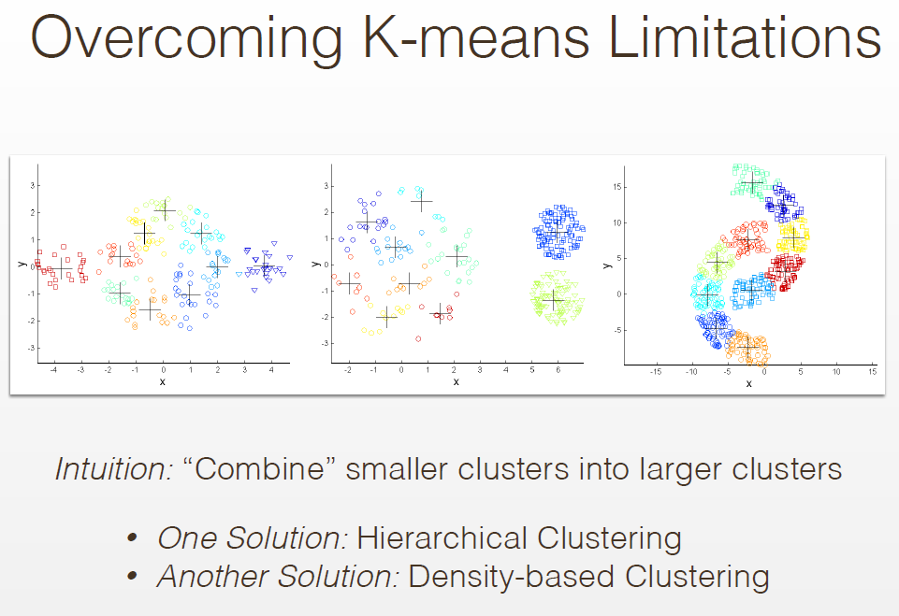

Slide 33
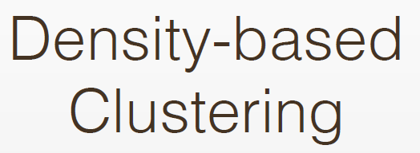

Slide 34
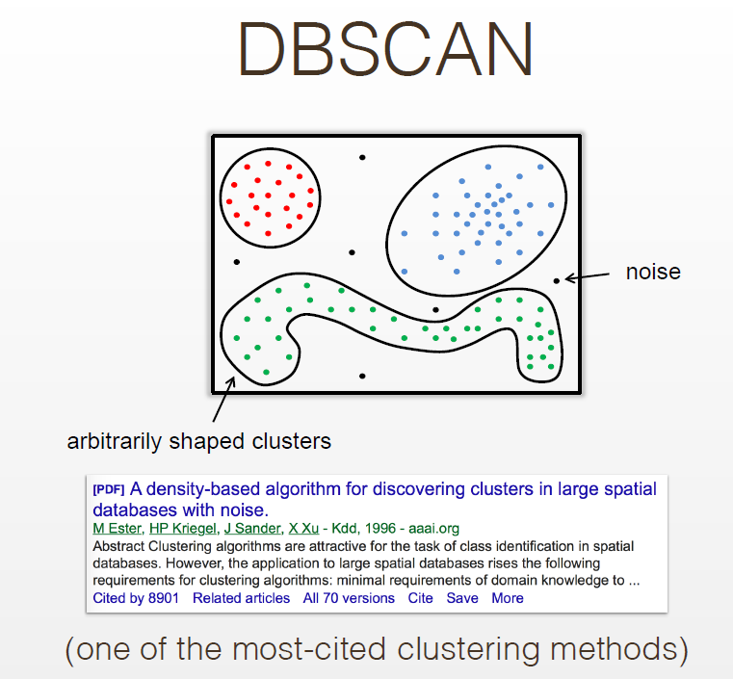

Slide 35
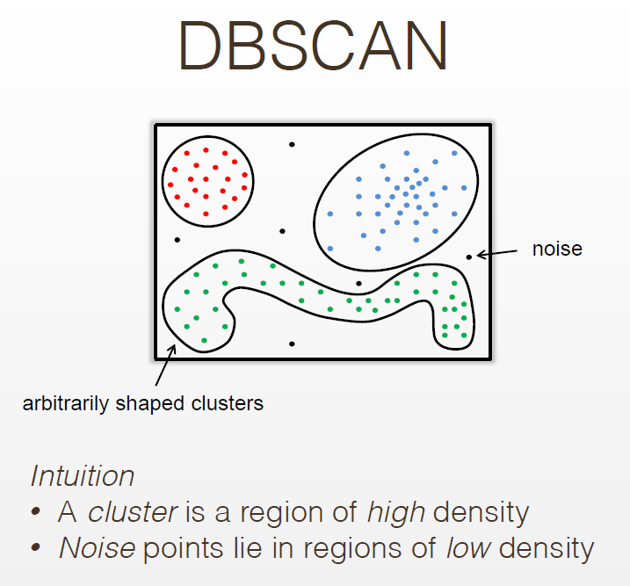

Slide 36
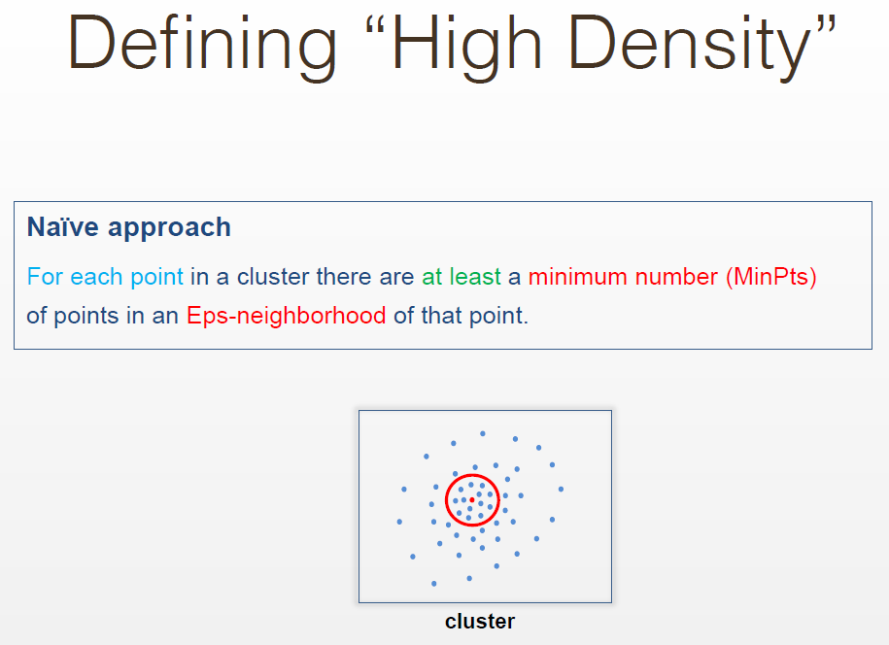

Slide 37
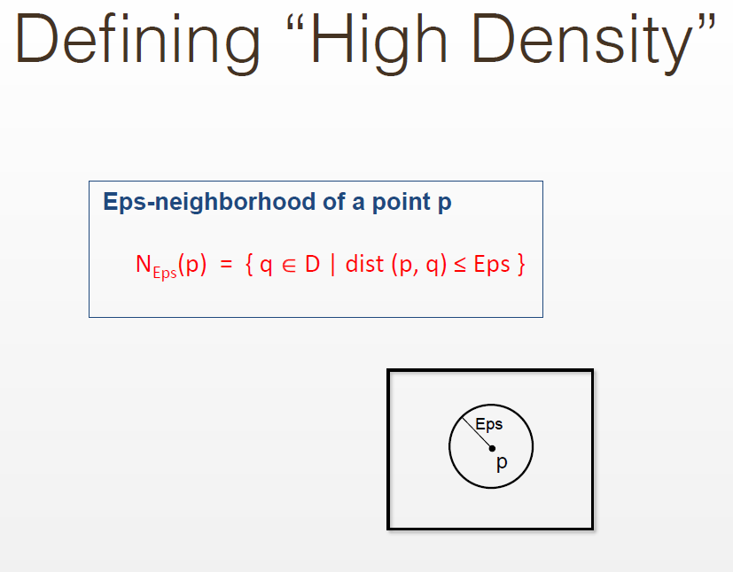

Slide 38
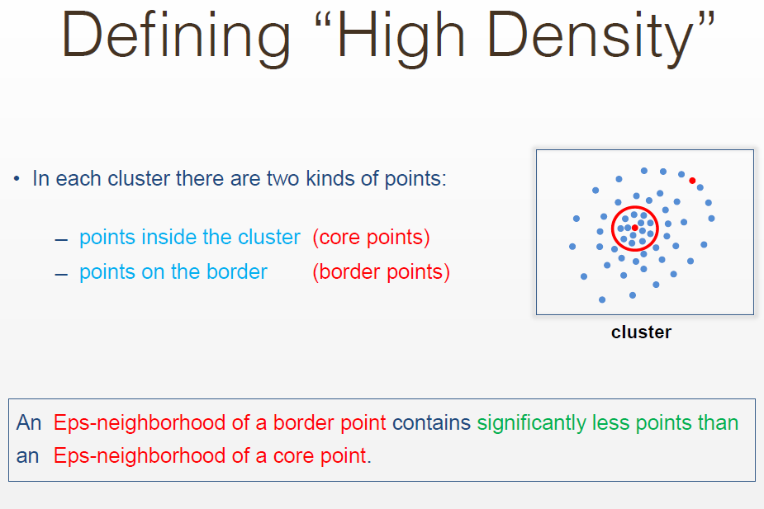

Slide 39
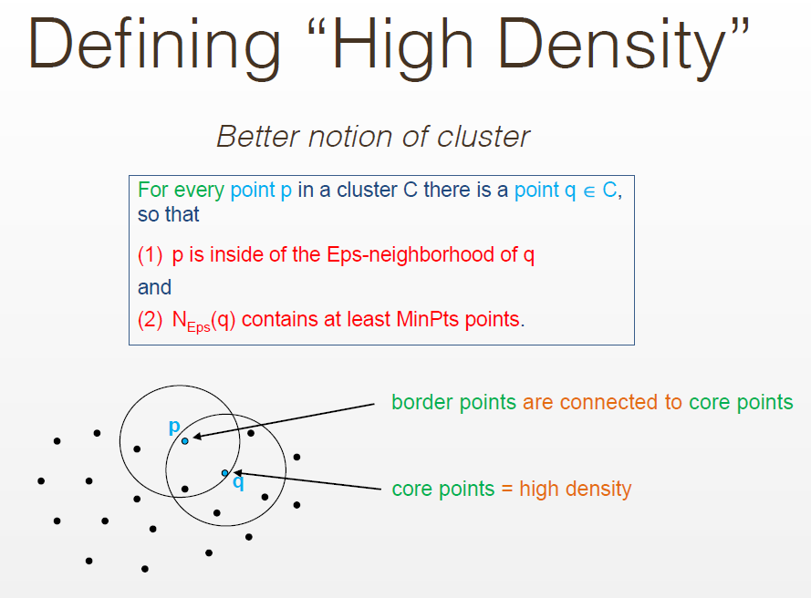

Slide 40
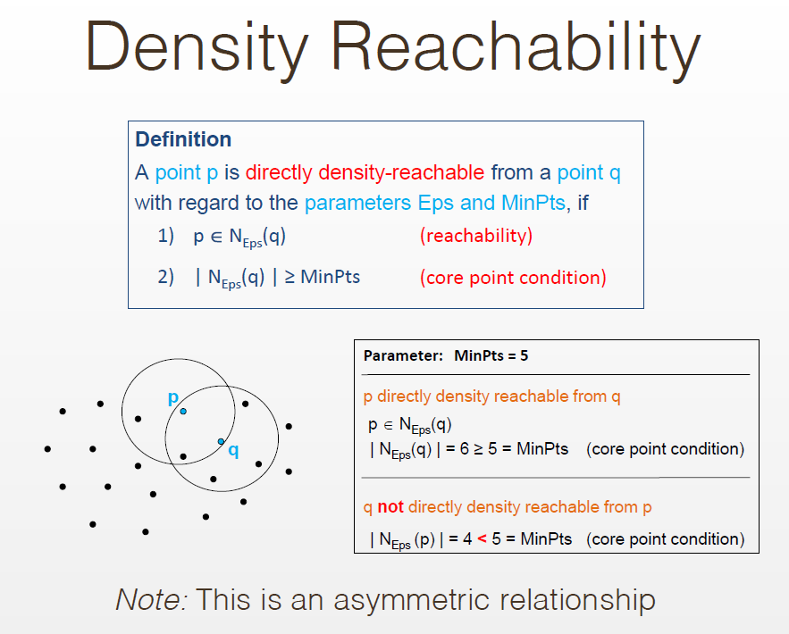

Slide 41
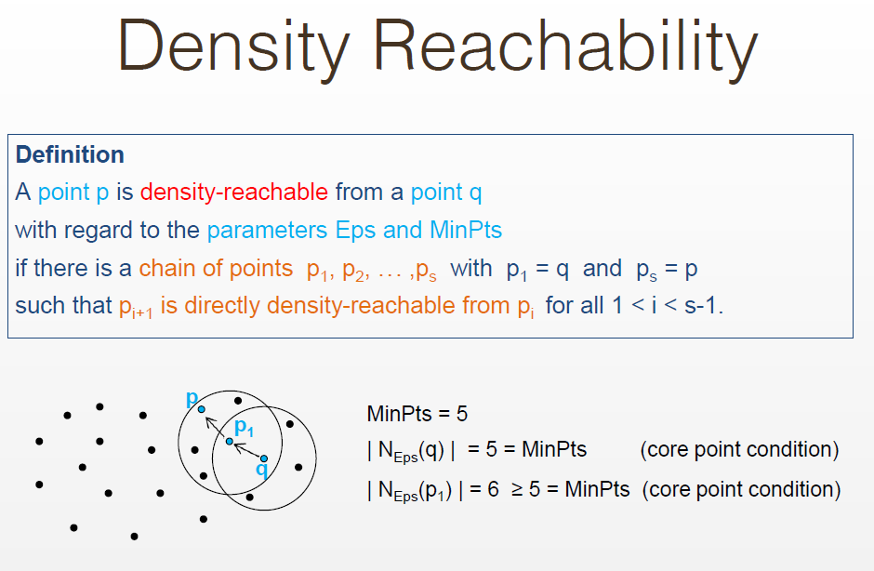

Slide 42
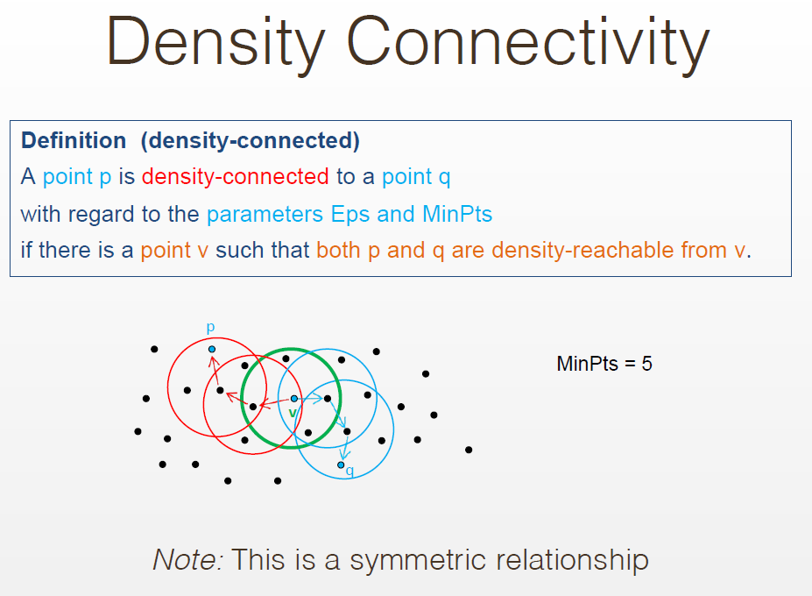

Slide 43
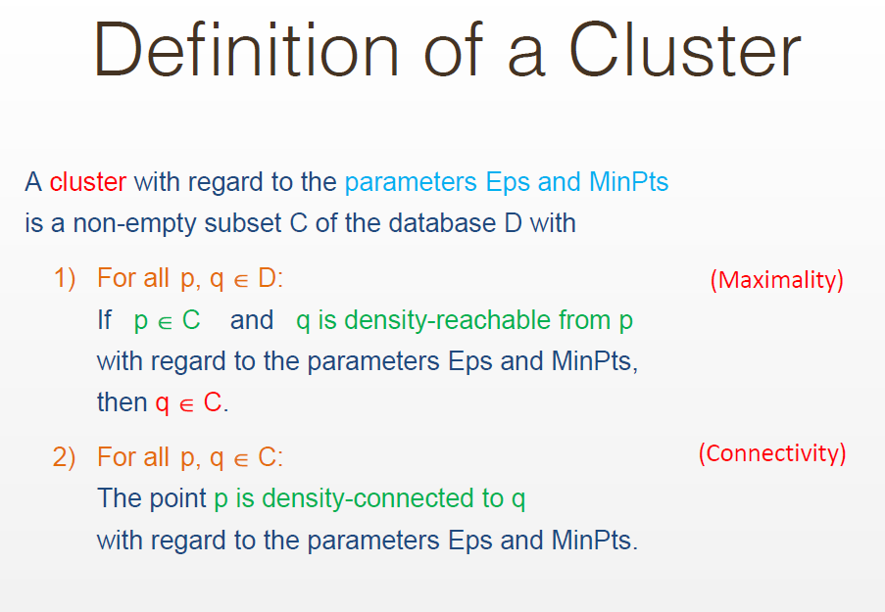

Slide 44
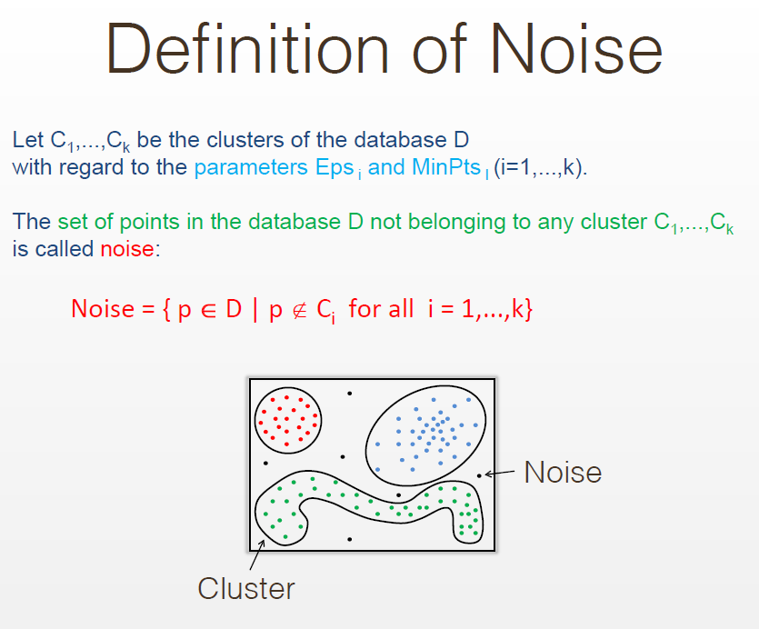

Slide 45
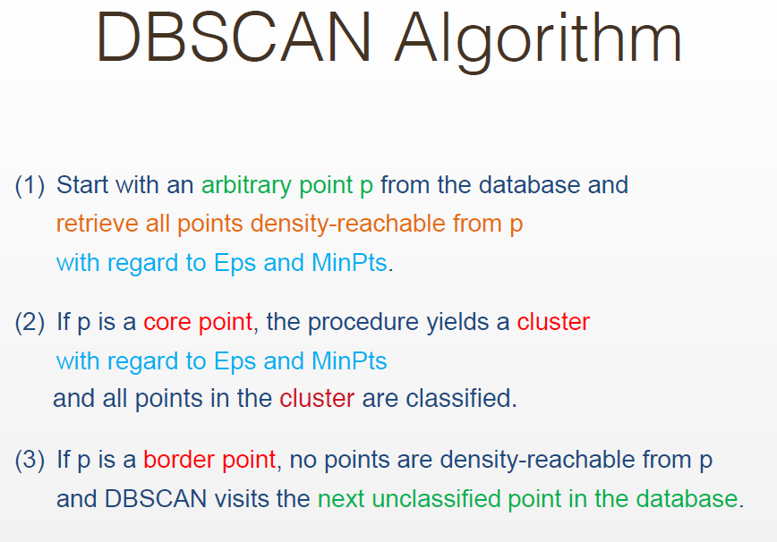

Slide 46
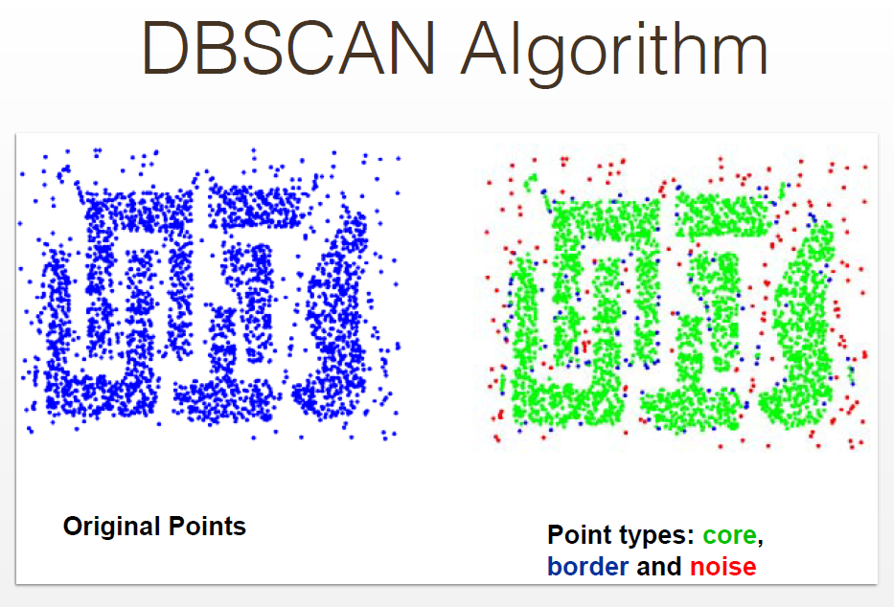

Slide 47
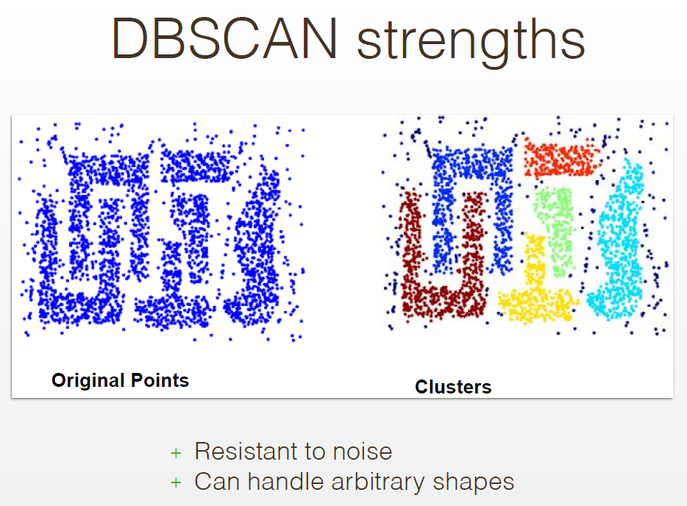

Slide 48
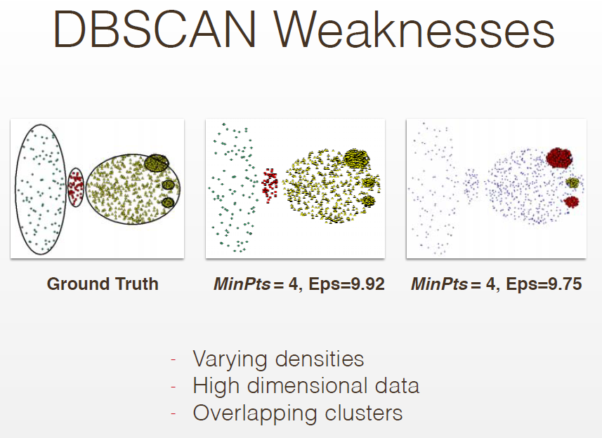

Slide 49
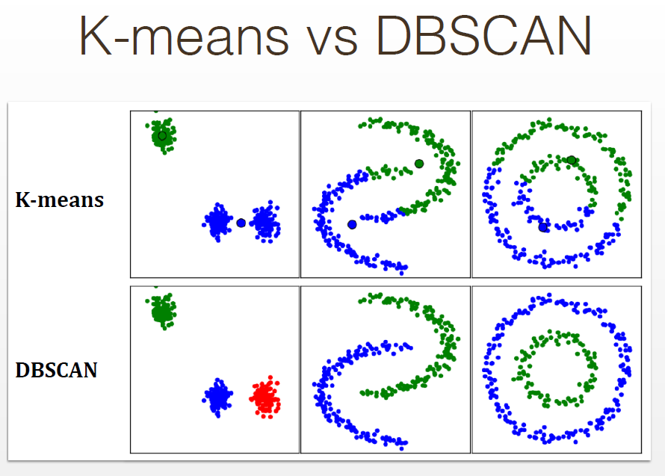

Slide 50
Visualizing K-Means and DBSCAN
https://www.naftaliharris.com/blog/visualizing-k-means-clustering/
https://www.naftaliharris.com/blog/visualizing-dbscan-clustering/

Slide 51
Future Topics: More Clustering Algorithms
Centroid-based
K-means
K-medoids
Connectivity-based (Hierarchical)
Hierarchical Agglomerative Clustering (HAC, bottom-up)
Hierarchical K-means (top-down)
Spectral Clustering (graph-based)
Density-based
DBSCAN
OPTICS
Distribution-based (Mixture Models)
Mixture of Gaussians
Expectation-Maximization (EM)

Slide 52
Future Unsupervised Learning Topics
Density Estimation Topics
Histograms
Kernel Density Estimation
Dimensionality Reduction
Principal Component Analysis (PCA)
t-SNE
UMAP
Autoencoders
Outlier Detection Topics
One-Class Classifier Learning
Autoencoders
Other Clustering Topics
HDBSCAN*
Cross-validation
Deep Neural Network Approaches
References:
The Hundred-Page Machine Learning Book. Andriy Burkov.
Applied Machine Learning in Python. Coursera. University of Michigan, Prof. Kevin Collins Thompson
Cluster analysis, https://en.wikipedia.org/w/index.php?title=Cluster_analysis&oldid=1002271612 (last visited Jan. 27, 2021).
Dimensionality reduction, https://en.wikipedia.org/w/index.php?title=Dimensionality_reduction&oldid=1002754996 (last visited Jan. 27, 2021).

Slide 53
Introducing Clustering Algorithms
Scott O’Hara
Metrowest Developers Machine Learning Group
03/03/2021

Slide 55
New Talk
Reference: Machine Learning: Clustering & Retrieval
University of Washington, Profs. Emily Fox & Carlos Guestrin
Reference: The Hundred-Page Machine Learning Book. Andriy Burkov.
Reference: Applied Machine Learning in Python. Coursera. University of Michigan, Prof. Kevin Collins Thompson

